Slide 1
Movie Booking Application with Recommendation
Home
About me
What I do
My experience
My work
CINEGENIE

Slide 2



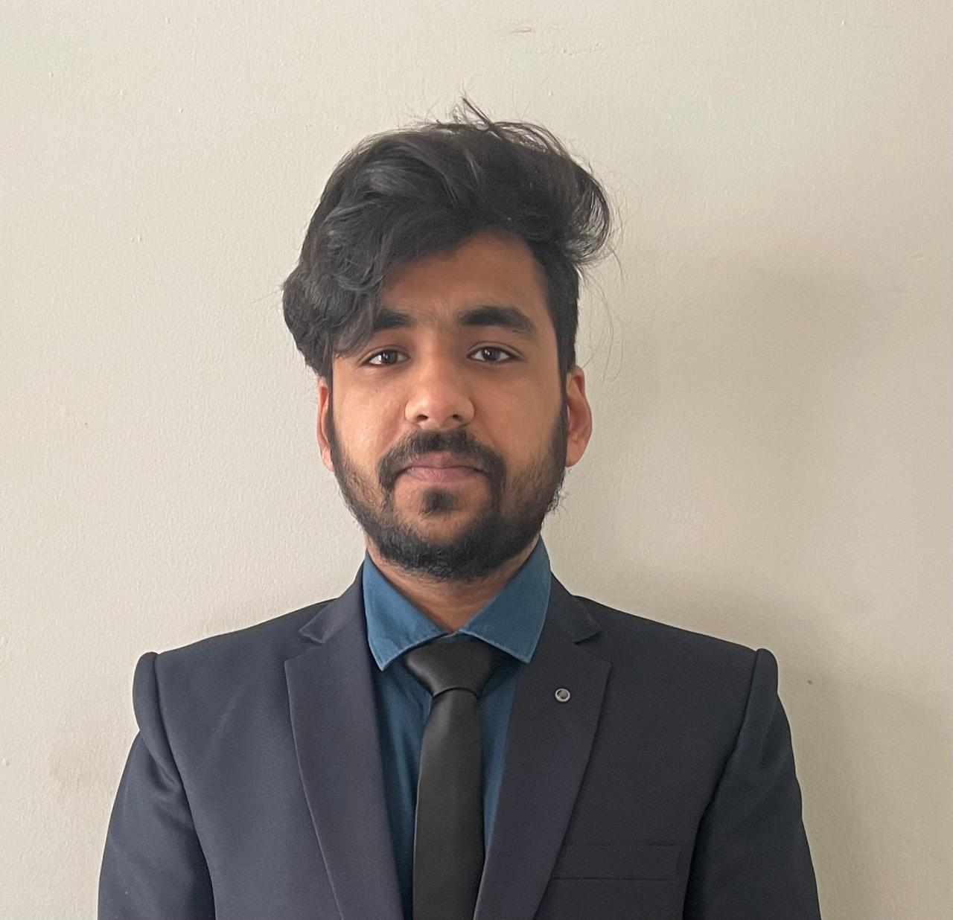

TEAM MEMBERS (GROUP 12)
Home
About me
What I do
My experience
My work
AKANKSHA NAKATI
002761992
NISHA SIRDESAI
002810901
JAYESH CHINDARKAR
002833099
SANAT POPLI
002201005
BHAGYA TRIVEDI
002765362

Slide 3
Home
About me
What I do
My experience
My work
Project Overview
An innovative movie booking application designed to revolutionize the way users choose and book movie tickets.
CineGenie provides personalized movie recommendations based on individual user preferences, viewing history, and trending data.
Created a seamless, user-centric platform that enhances movie discovery and simplifies the booking process.

Slide 4







TECHNOLOGY USED
Home
About me
What I do
My experience
My work

Slide 5
USER ROLE
Home
About me
What I do
My experience
My work
HOME PAGE
SEAT BOOKING
SAVE PREFERENCES
PAYMENT GATEWAY
LOGIN/SIGN UP
MOVIE LIST
TICKET

Slide 6
THEATRE ADMIN ROLE
Home
About me
What I do
My experience
My work
VIEW MOVIE DETAILS
LOGIN/SIGN UP
ADD MOVIES

Slide 7
ADMIN ROLE
Home
About me
What I do
My experience
My work
VIEW THEATER DETAILS
LOGIN/SIGN UP
ADD THEATER

Slide 8

Now, Let’s proceed with the Demo
Home
About me
What I do
My experience
My work

